Slide 1
Visual motion analysis of the player’s finger
IACV project 2023
Emanuele Paesano, Alessio Hu

Slide 2
Problem formulation
Goal:
extract the sequence of notes of a song, using only image analysis and computer vision tools and concepts.
Tools:
Python
MediaPipe
Opencv-python
Tensorflow

Slide 3
Implementation

Slide 4
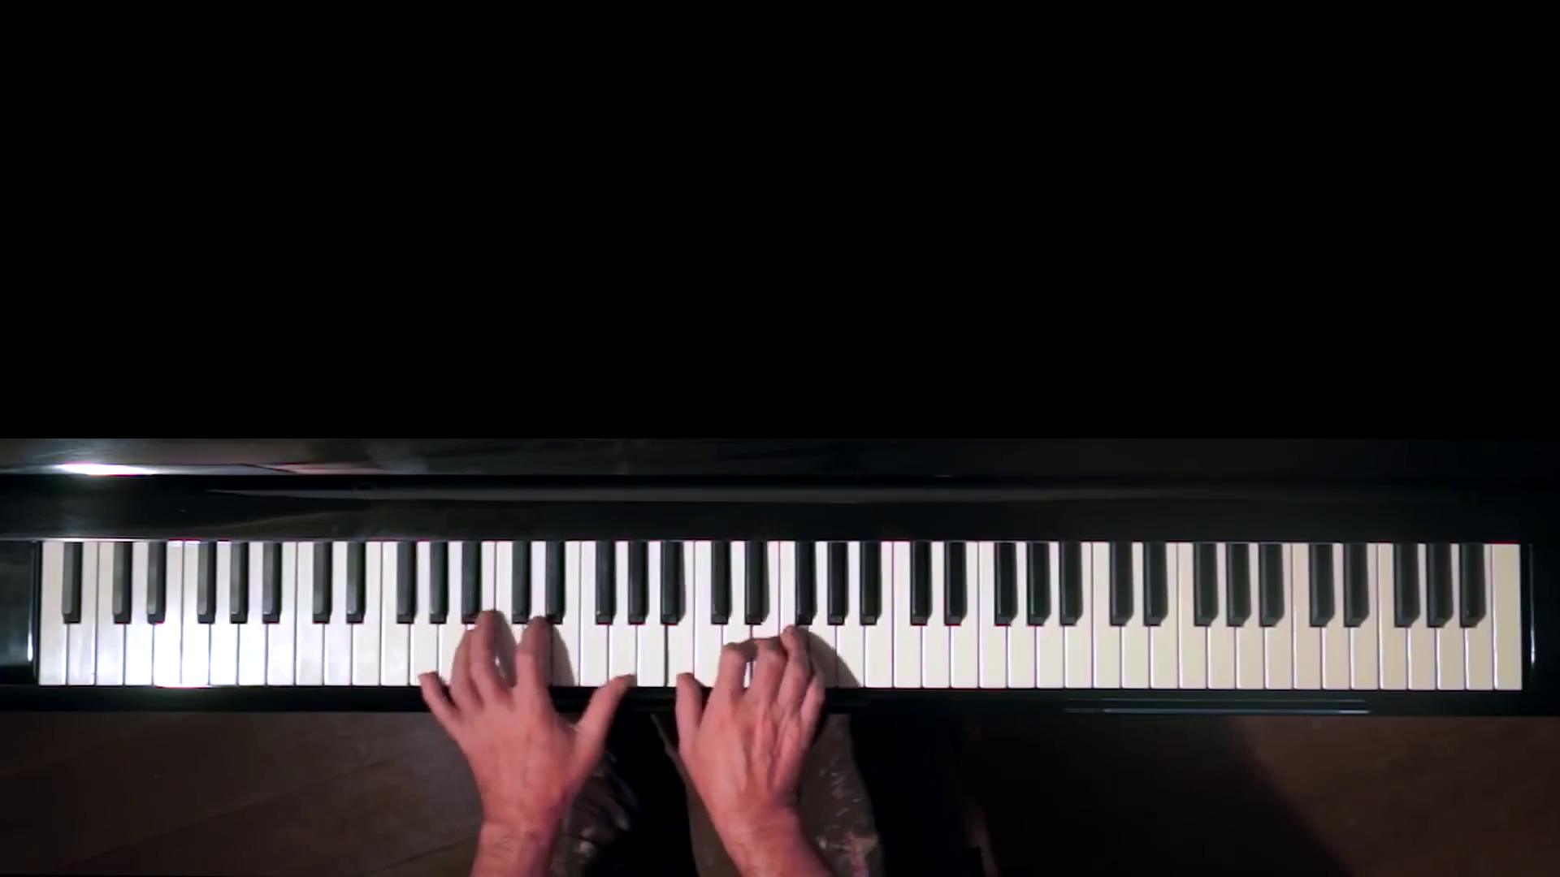
Data and camera setup
Data extracted from YouTube videos
Camera placed above the piano

Slide 5
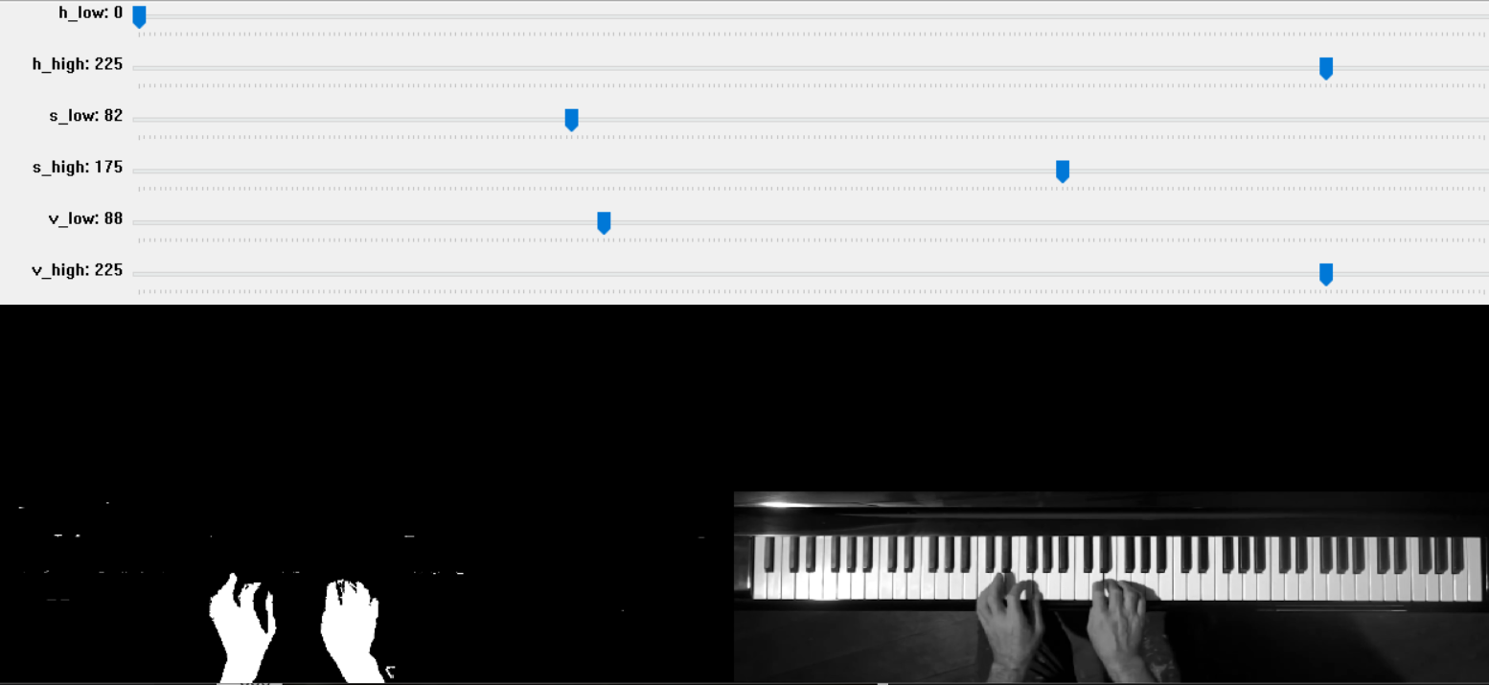
Hand and keyboard segmentation
a) Manual extraction - HSV value thresholding

Slide 6
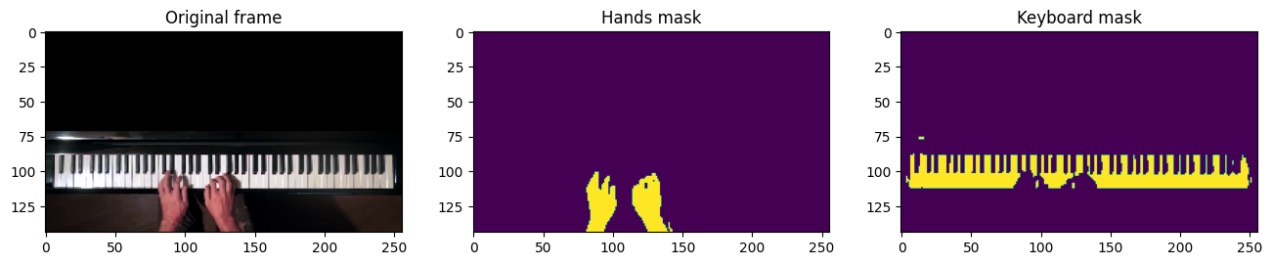
Hand and keyboard segmentation
b) Neural network segmentation - Train on manually selected masks

Slide 7
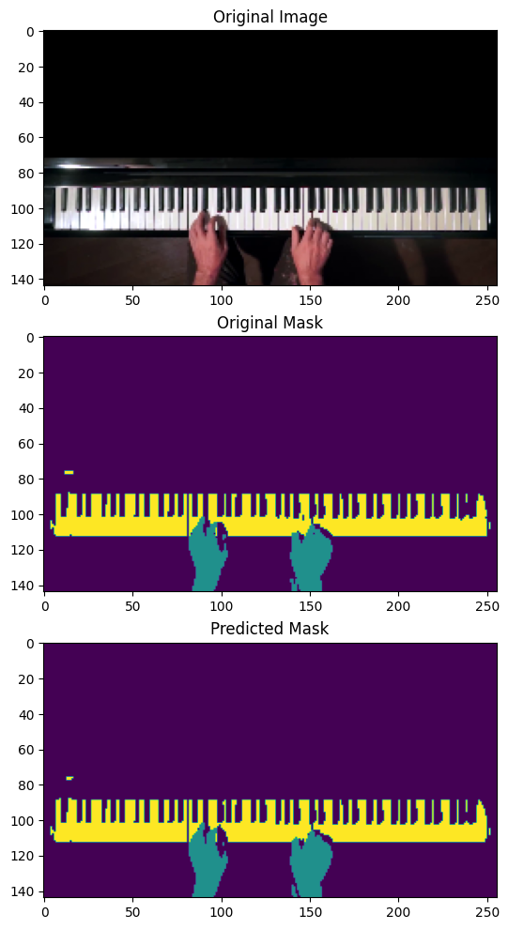
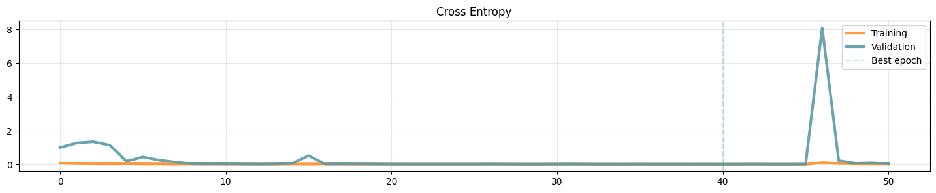
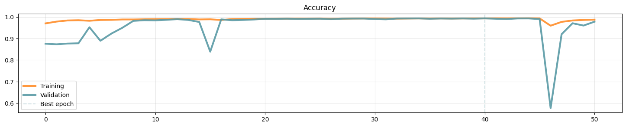
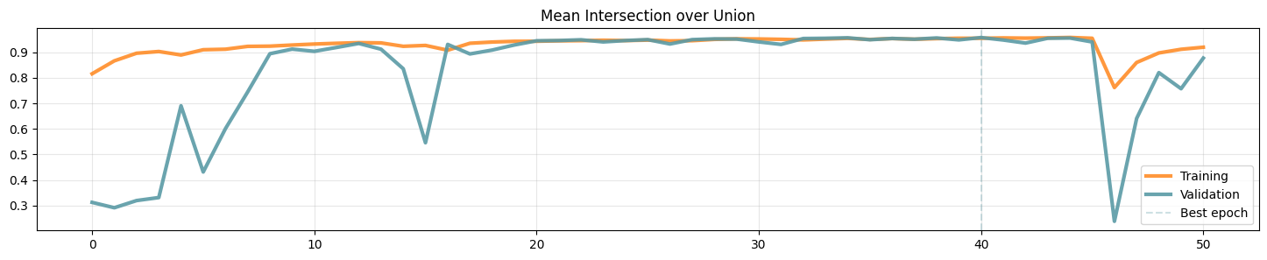

Slide 8
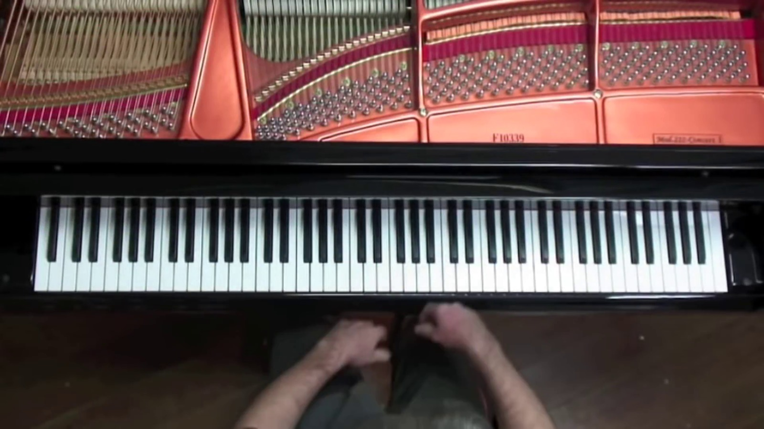
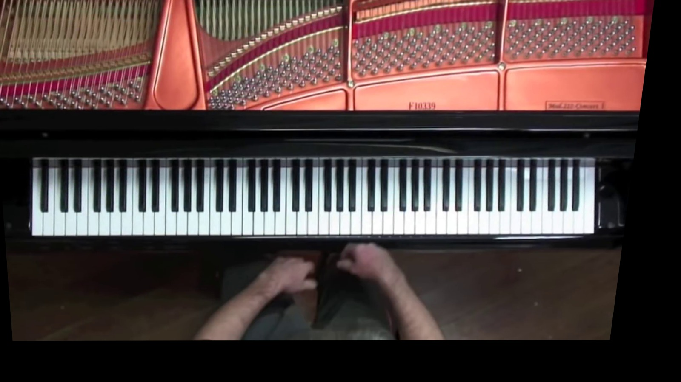
Keyboard rectification
Horizontal keyboard is the ideal setting
Compute homography between keyboard and ideal shape

Slide 9
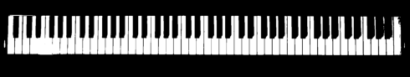
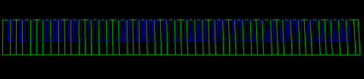
Key regions retrieval
Map every piano key to a well defined region
Exploit patterns of 1’s and 0’s to detect black and white keys

Slide 10
Detection of pressed keys
1) use shadows to select candidate keys
WHITE KEYS:
NOT
OR
=
(3)
(2)
AND
=
(1)
Notes:
3: keyboard mask in current frame
2: hand mask current frame
1: fixed keyboard

Slide 11
BLACK KEYS:
NOT
=
AND
=
(2)
(1)
XOR
=
XOR
(3)
Notes:
1: fixed keyboard
2: hand mask current frame
3: keyboard current frame

Slide 12
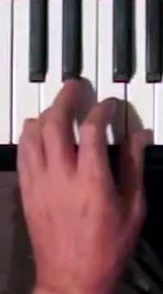
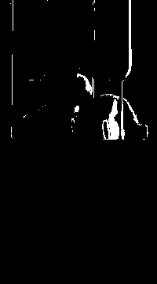
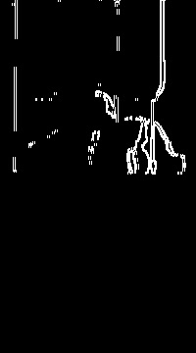
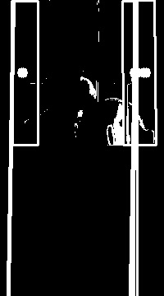
2) Exclude small shadows keys keys through Sobel and Hough lines
ORIGINAL
WHITE
SHADOWS MASK
SOBEL
HOUGH
Notes:
Original -> after logic -> edge detection -> hough transform . With this we identify the candidate keys which are the regions highlighted in last image

Slide 13
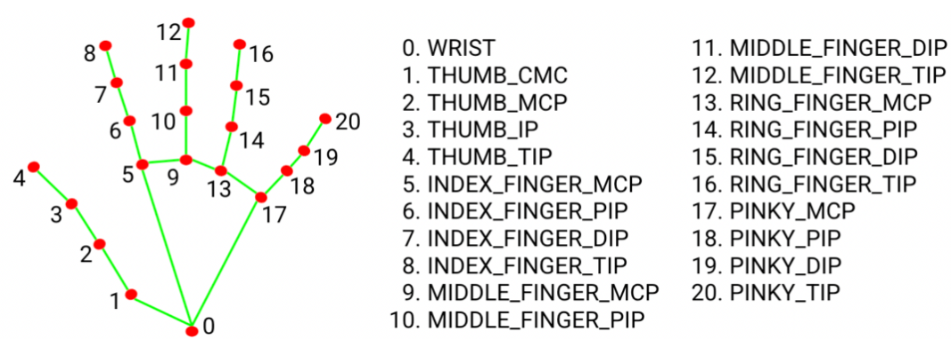
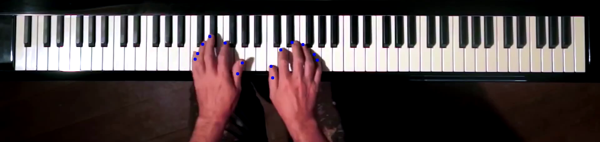
3) Use MediaPipe to find finger positions
Notes:
Media pipe library, offers many tools that are intended for machine learning applications of several types, but has a useful part for computer vision.

Slide 14
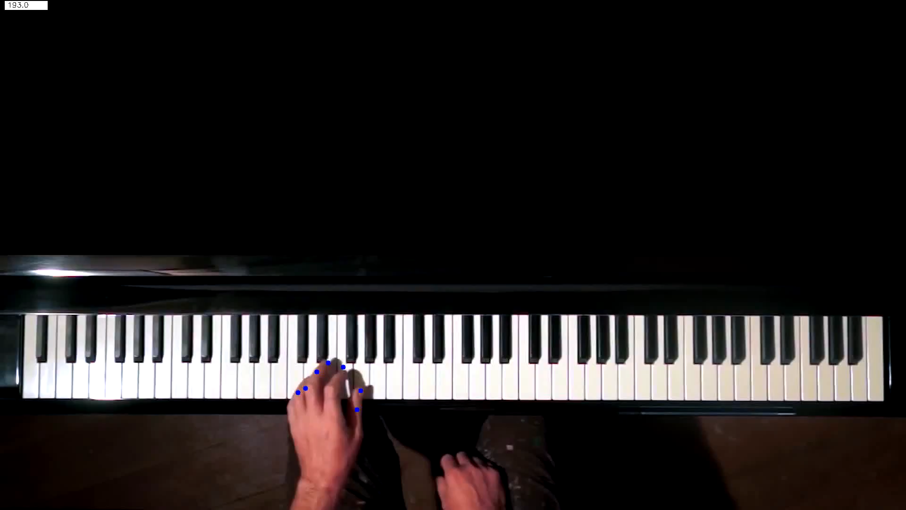
4) Final selection of pressed keys
Notes:
In the final selection, we discard the candidate keys that do not have a finger landmark in them. In the video we see overlayed the key detections in green.

Slide 16
Results
Notes:
In the end, we end up with a list of notes which we convert to MiDi format in order to play it

Slide 17

With manual mask:
With neural network:

Slide 18
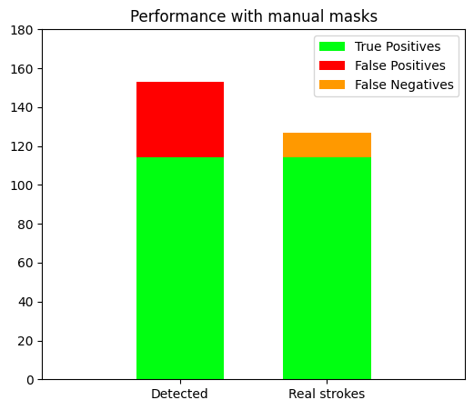
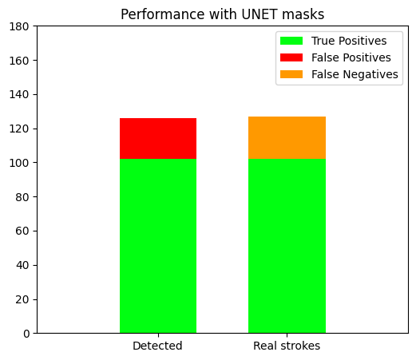
Performance from some manually selected frames
Notes:
We selected around 180 notes manually from some frames of the video. Most of the real strokes are correctly detected, with the manual mask doing more false positives than the neural network. The overall performance is similar

